Slide 1

AISI439
Indenter radius: 1um 2um 5um 20 um
Loading rate 20nm/s
For each indenter radius:
a/R=0.25 and a/R=0.5 are tested
a: contact radius
R: Indenter radius
1

Slide 2
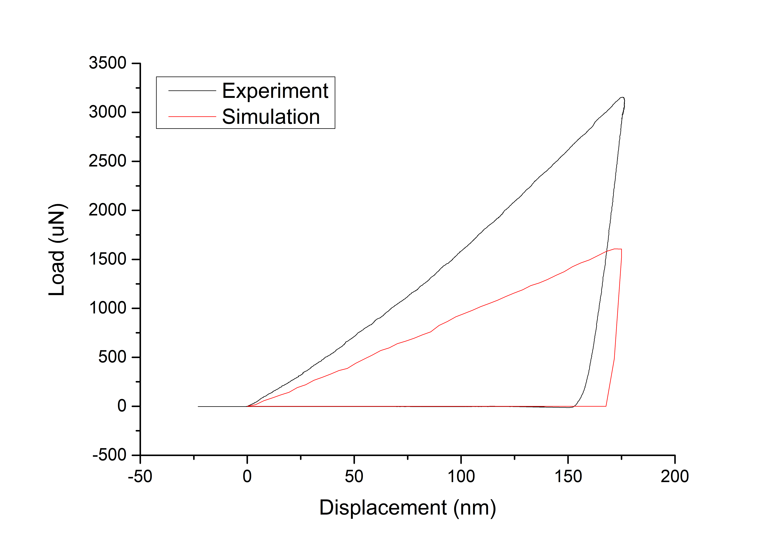
AISI439
Indenter radius 1um
Critical area: 2um
Minimum mesh: 0.1um
tau0 | 105
taucs | 234
h0 | 800
A | 1.2
m | 77.3
1

Slide 3
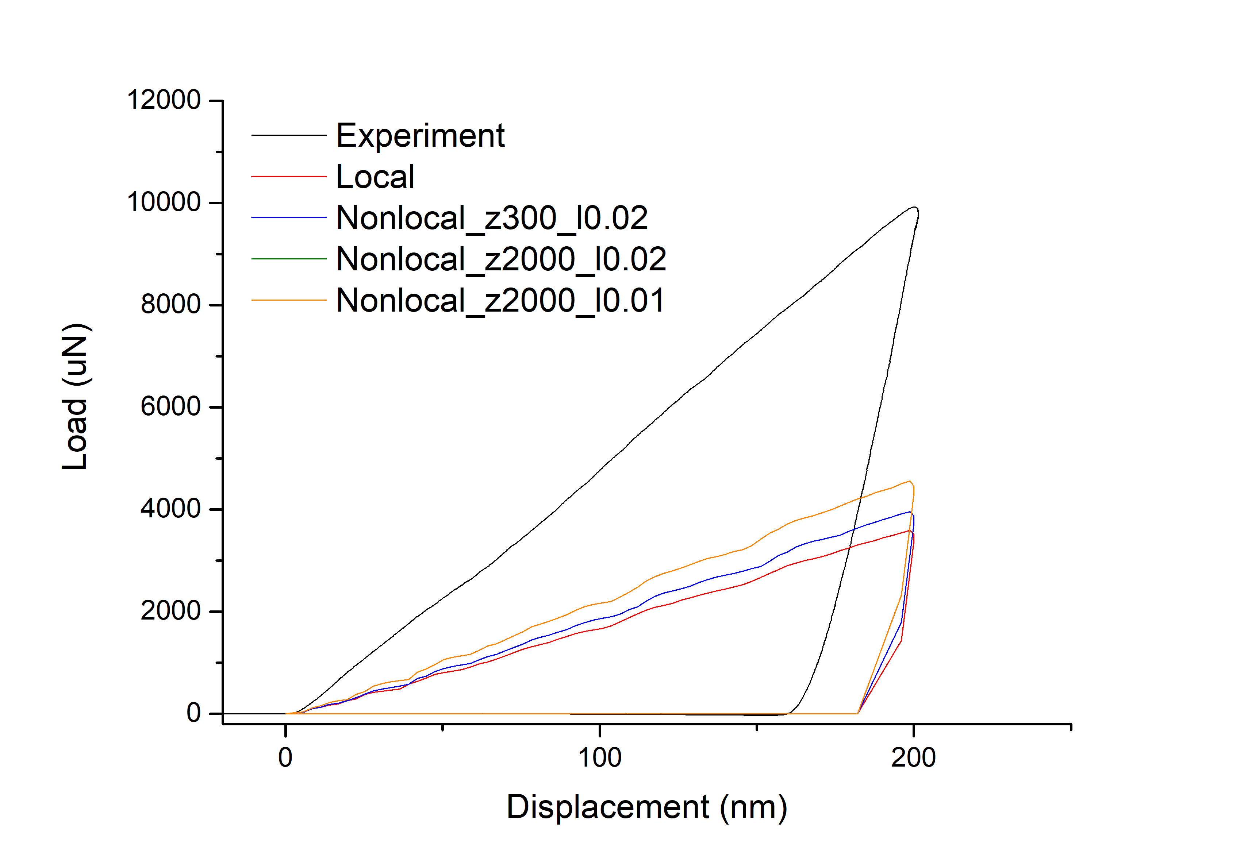
AISI439
Indenter radius 2um
Critical area: 2.5um
Minimum mesh: 0.125um
tau0 | 105
taucs | 234
h0 | 800
A | 1.2
m | 77.3
1

Slide 4
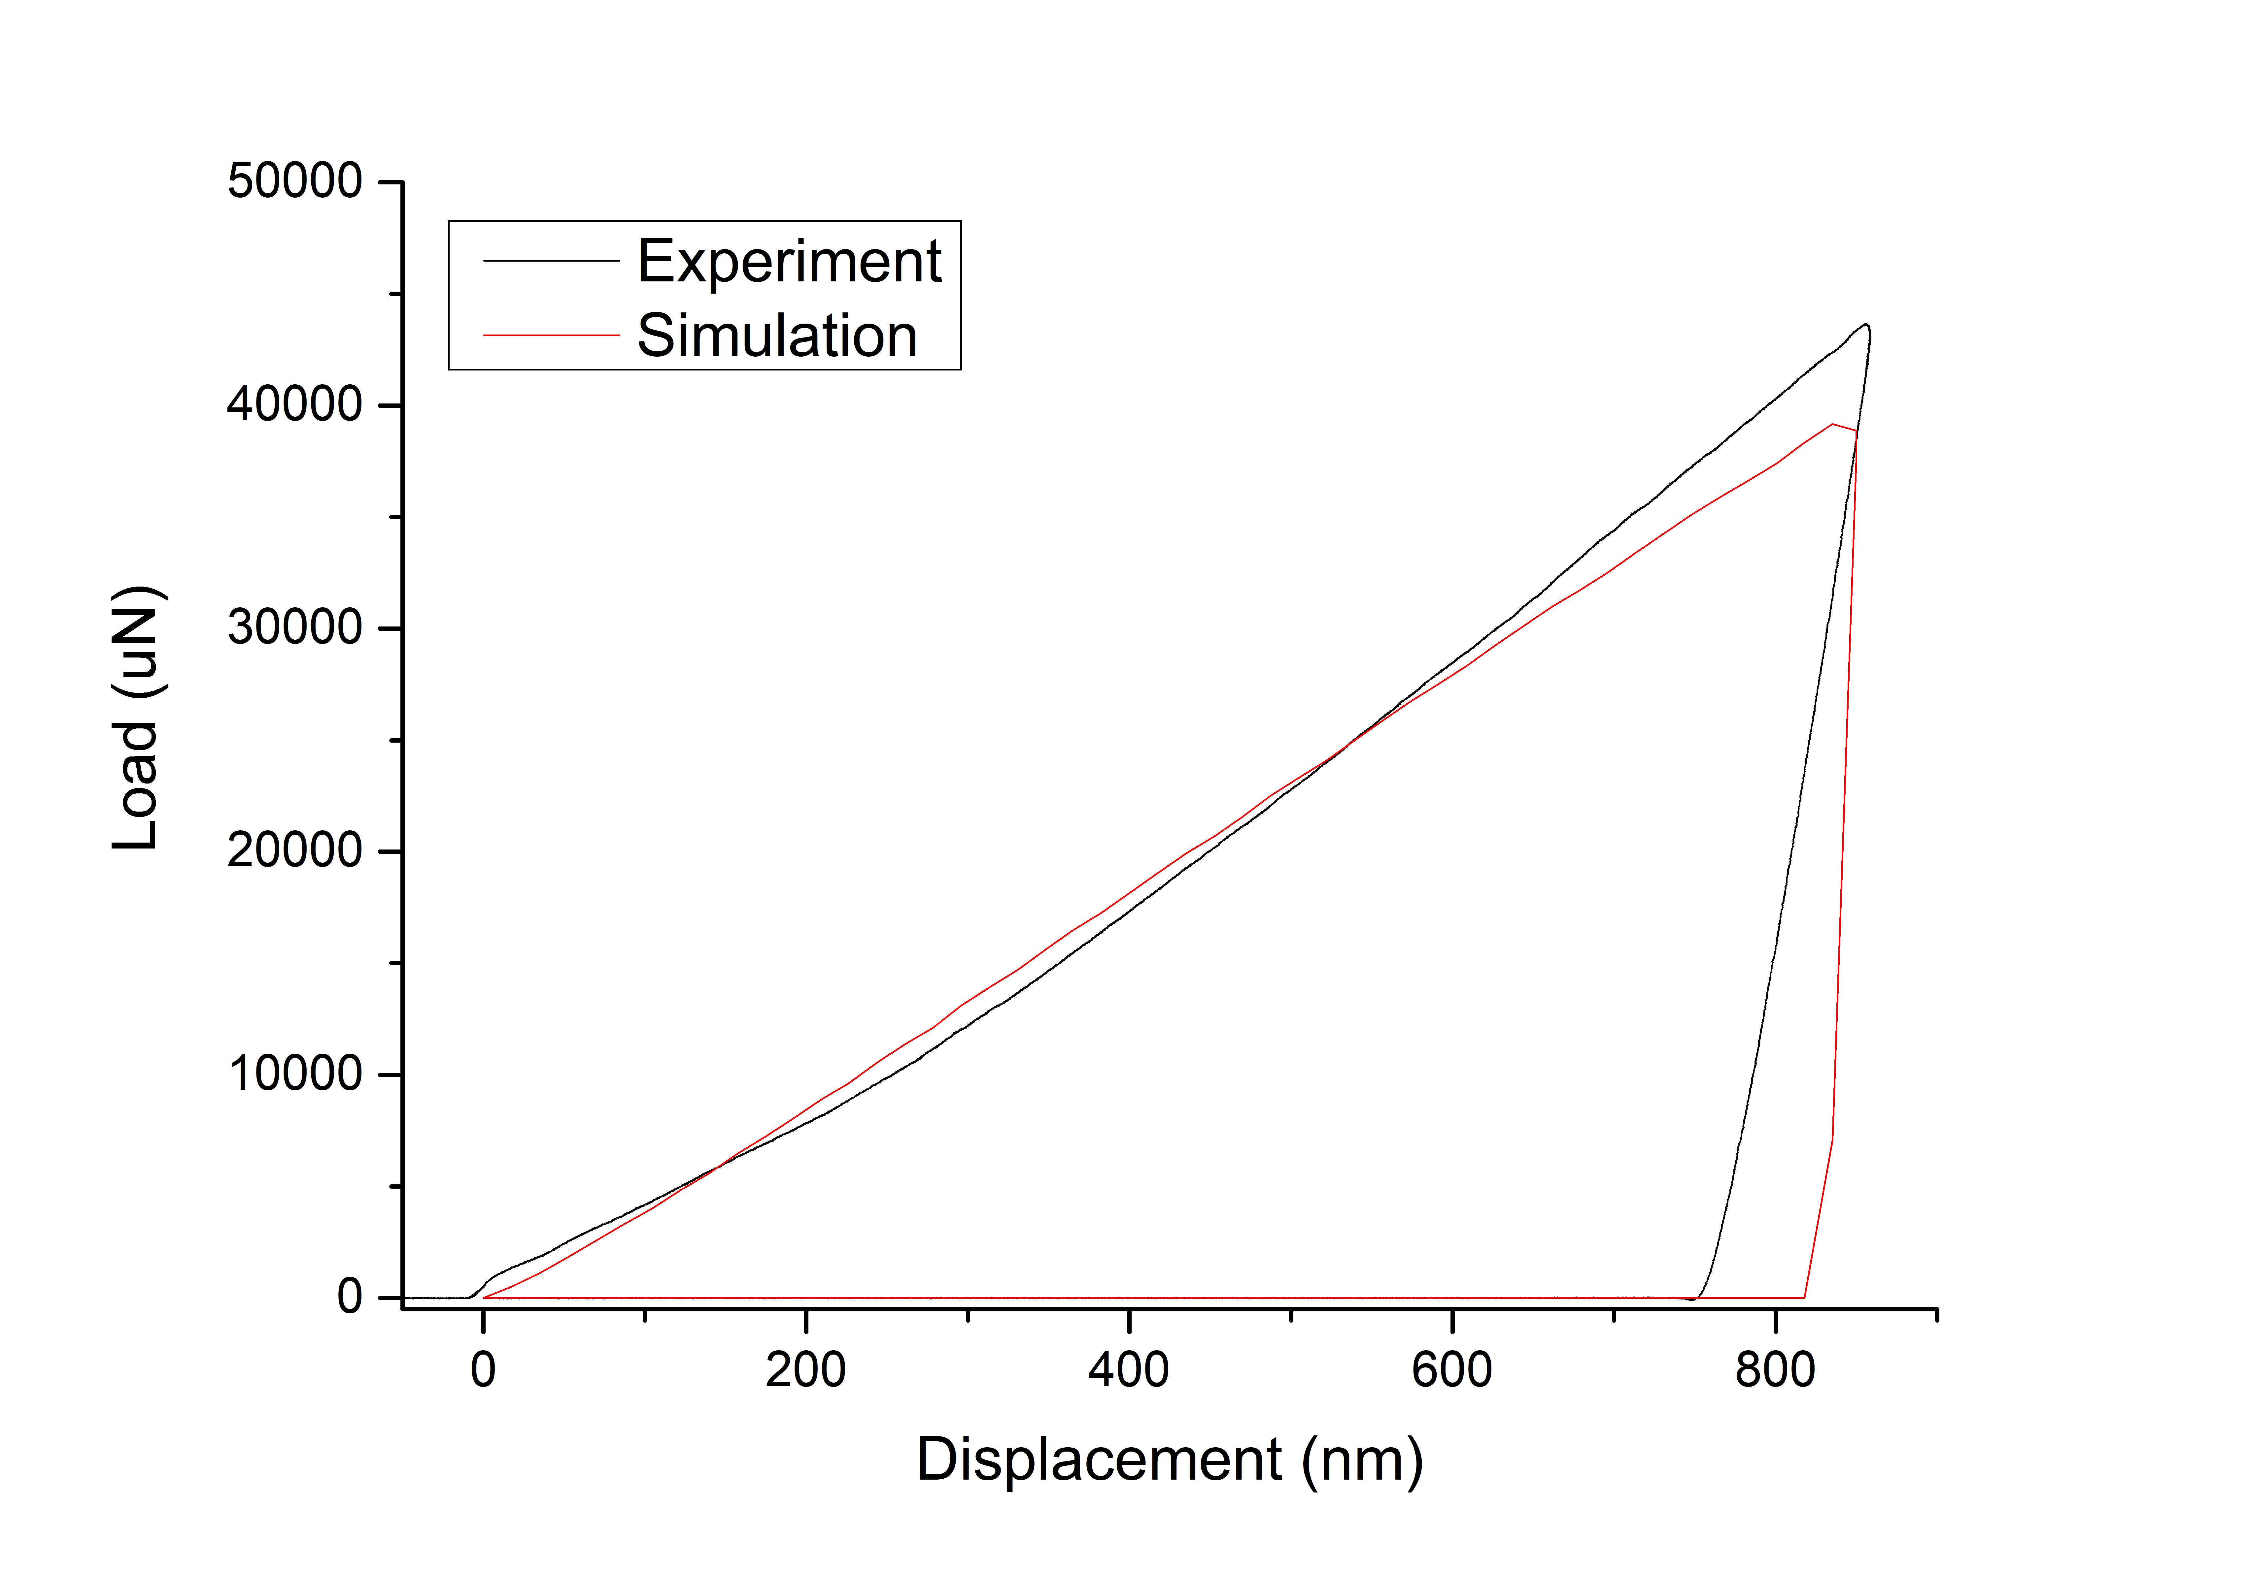
AISI439
Indenter radius 5um
Critical area: 3um
Minimum mesh: 0.15um
tau0 | 105
taucs | 234
h0 | 800
A | 1.2
m | 77.3
1

Slide 5
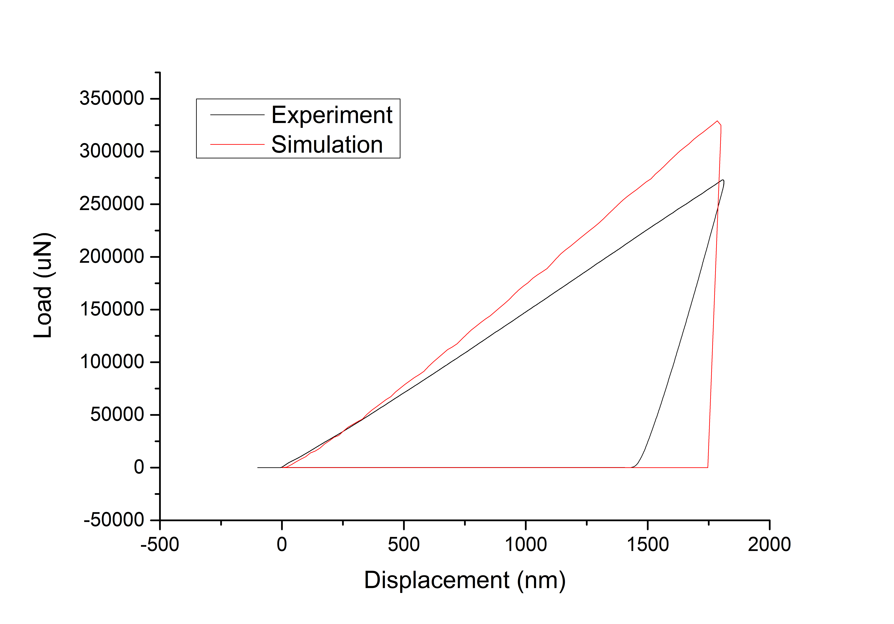
AISI439
Indenter radius 20um
Critical area: 12um
Minimum mesh: 0.6um
tau0 | 105
taucs | 234
h0 | 800
A | 1.2
m | 77.3
1

Slide 6
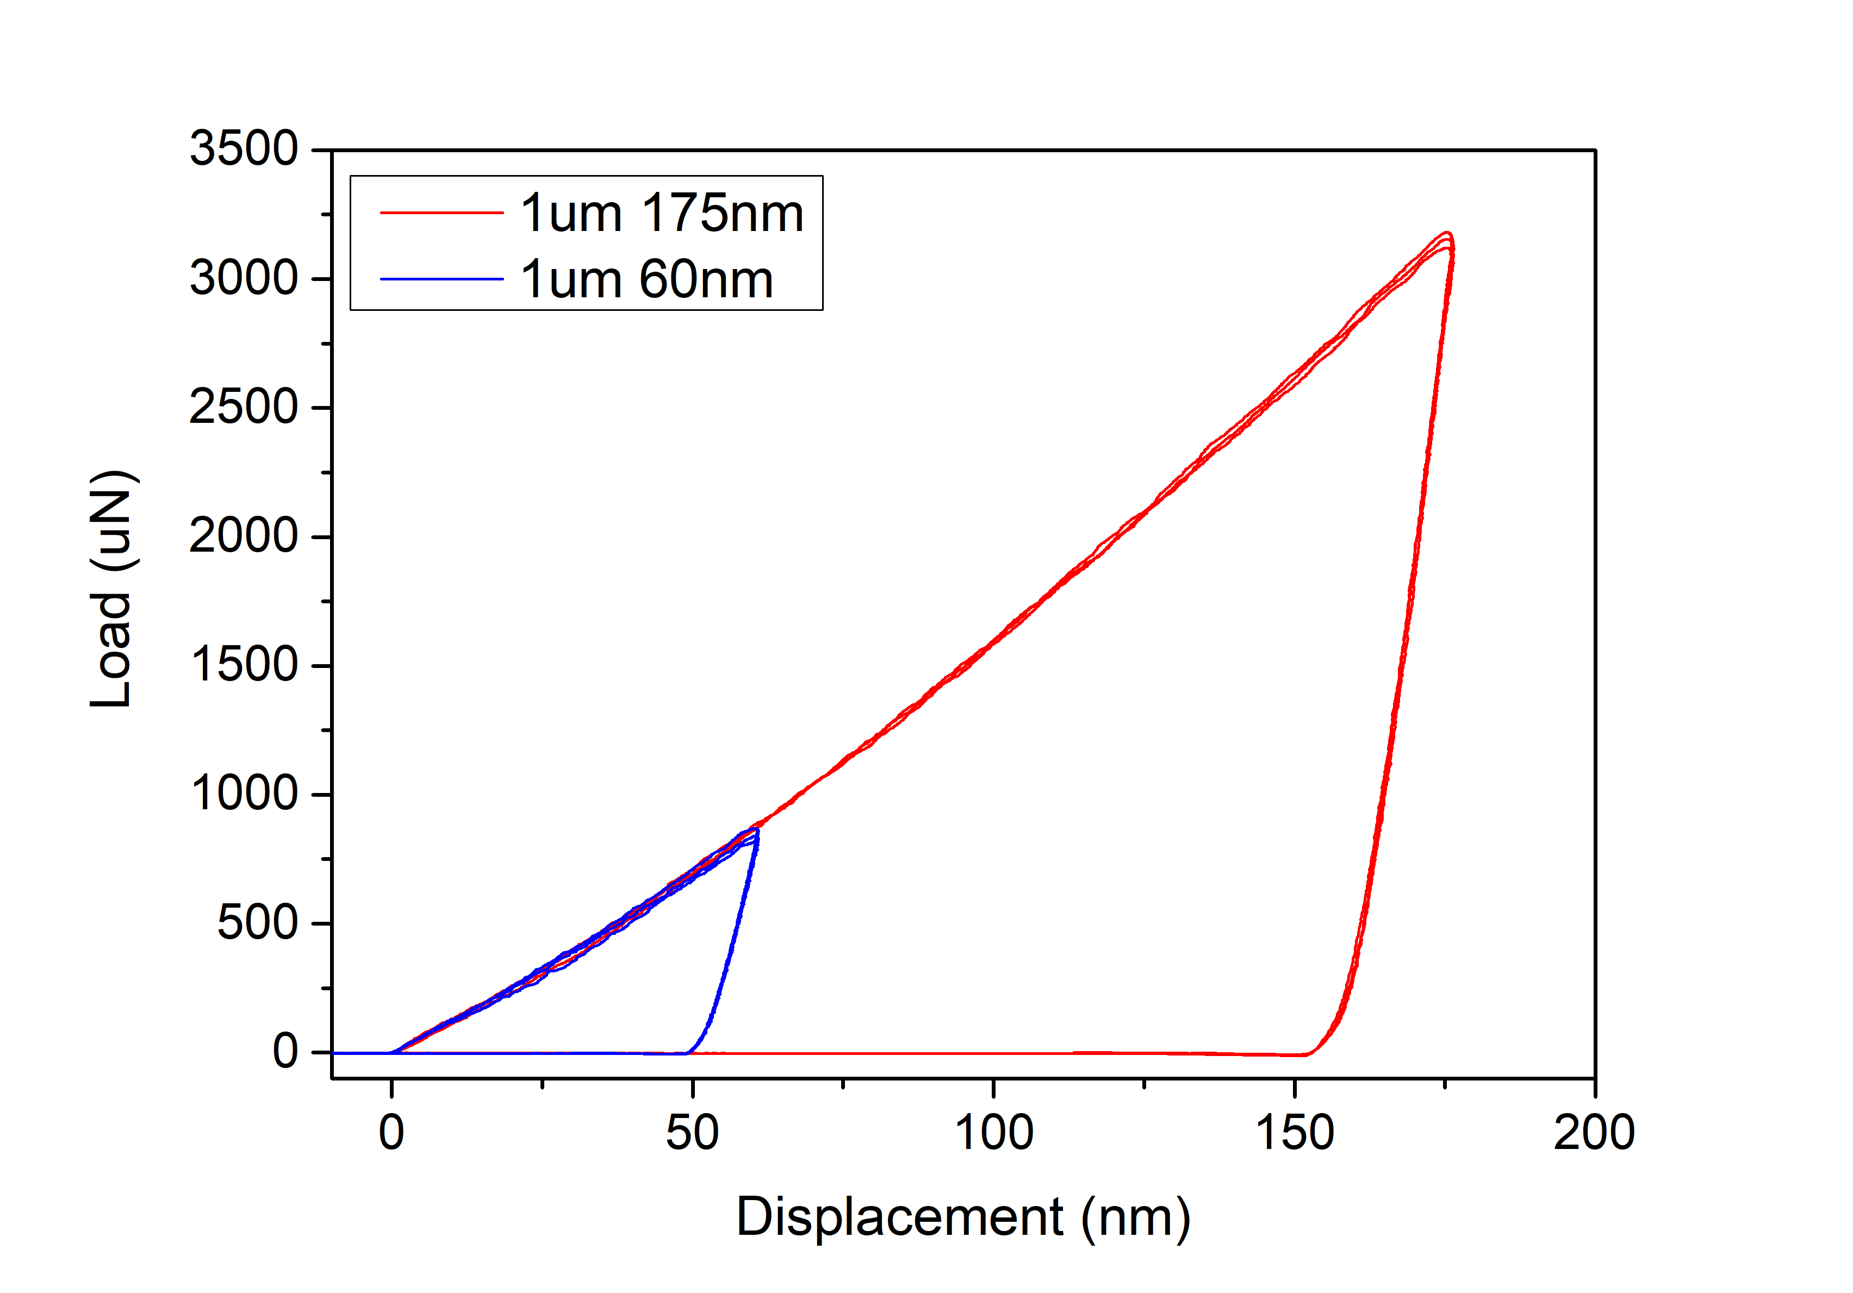
AISI439
Indenter radius 1um
1

Slide 7
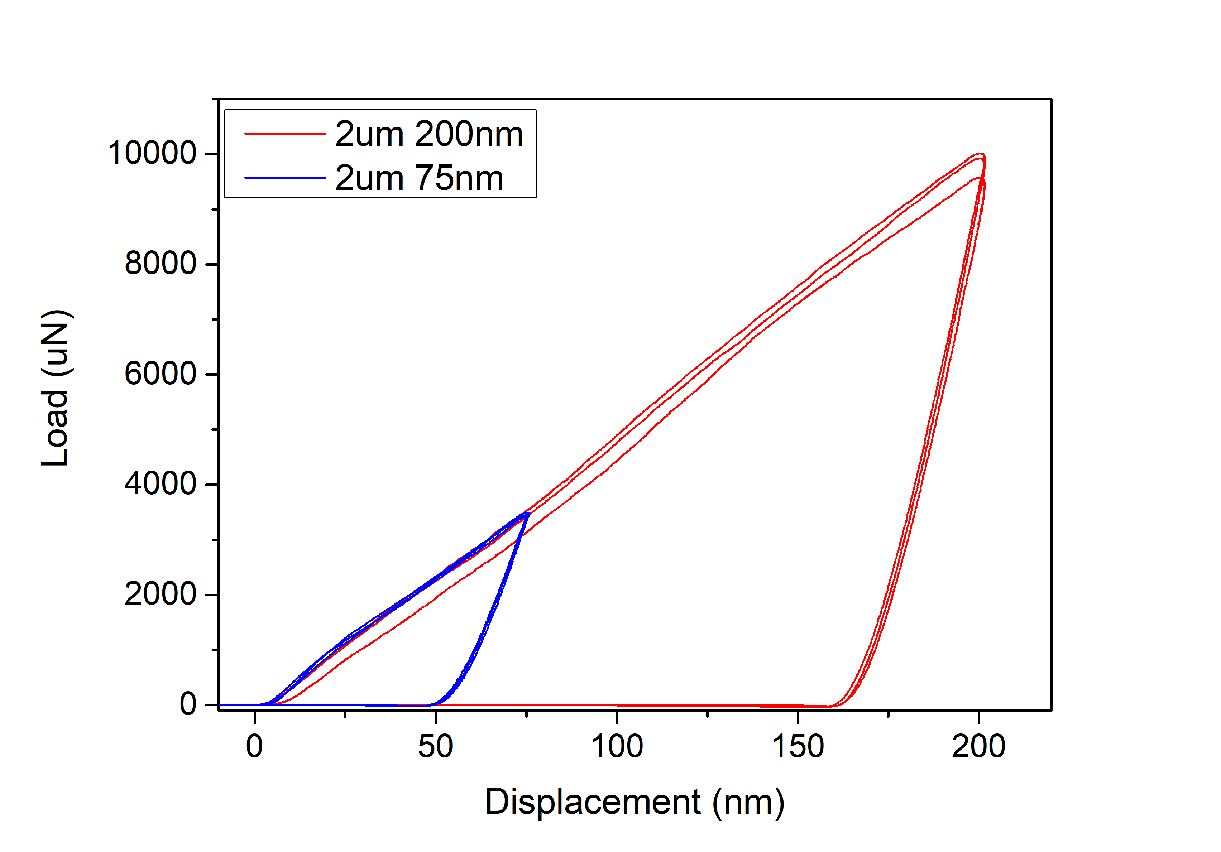
AISI439
Indenter radius 2um?
1

Slide 8
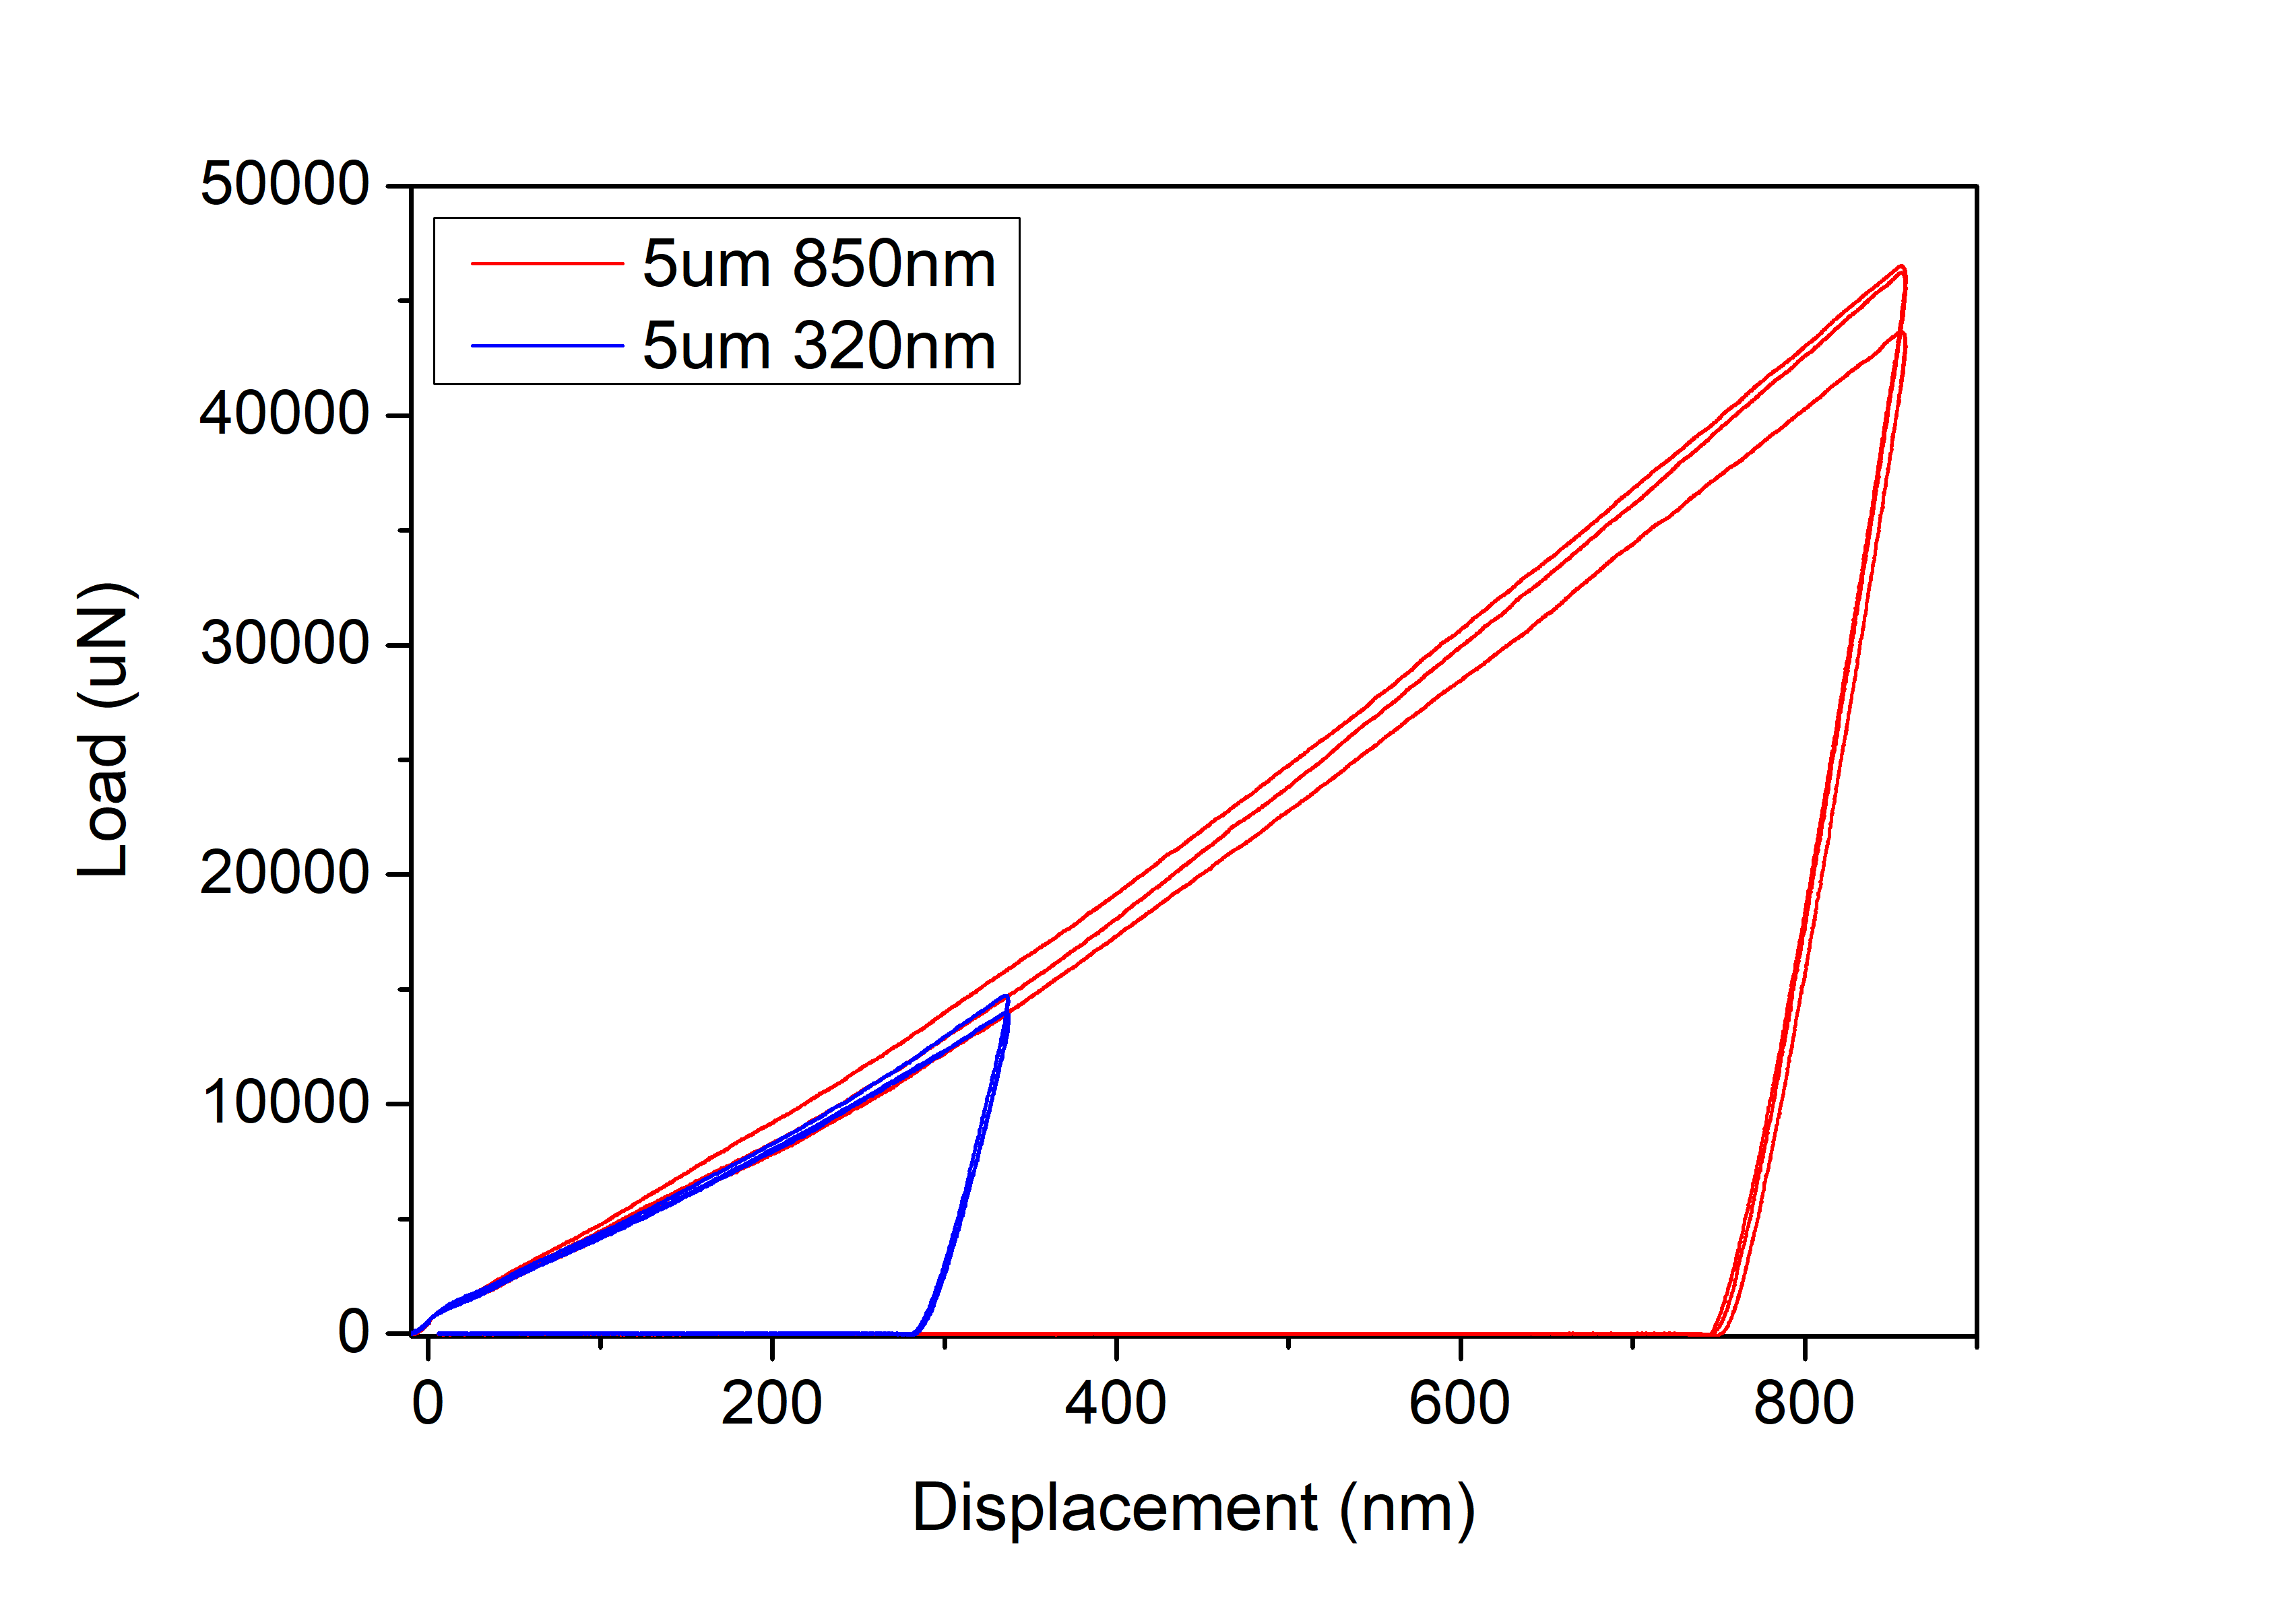
AISI439
Indenter radius 5um
1

Slide 9
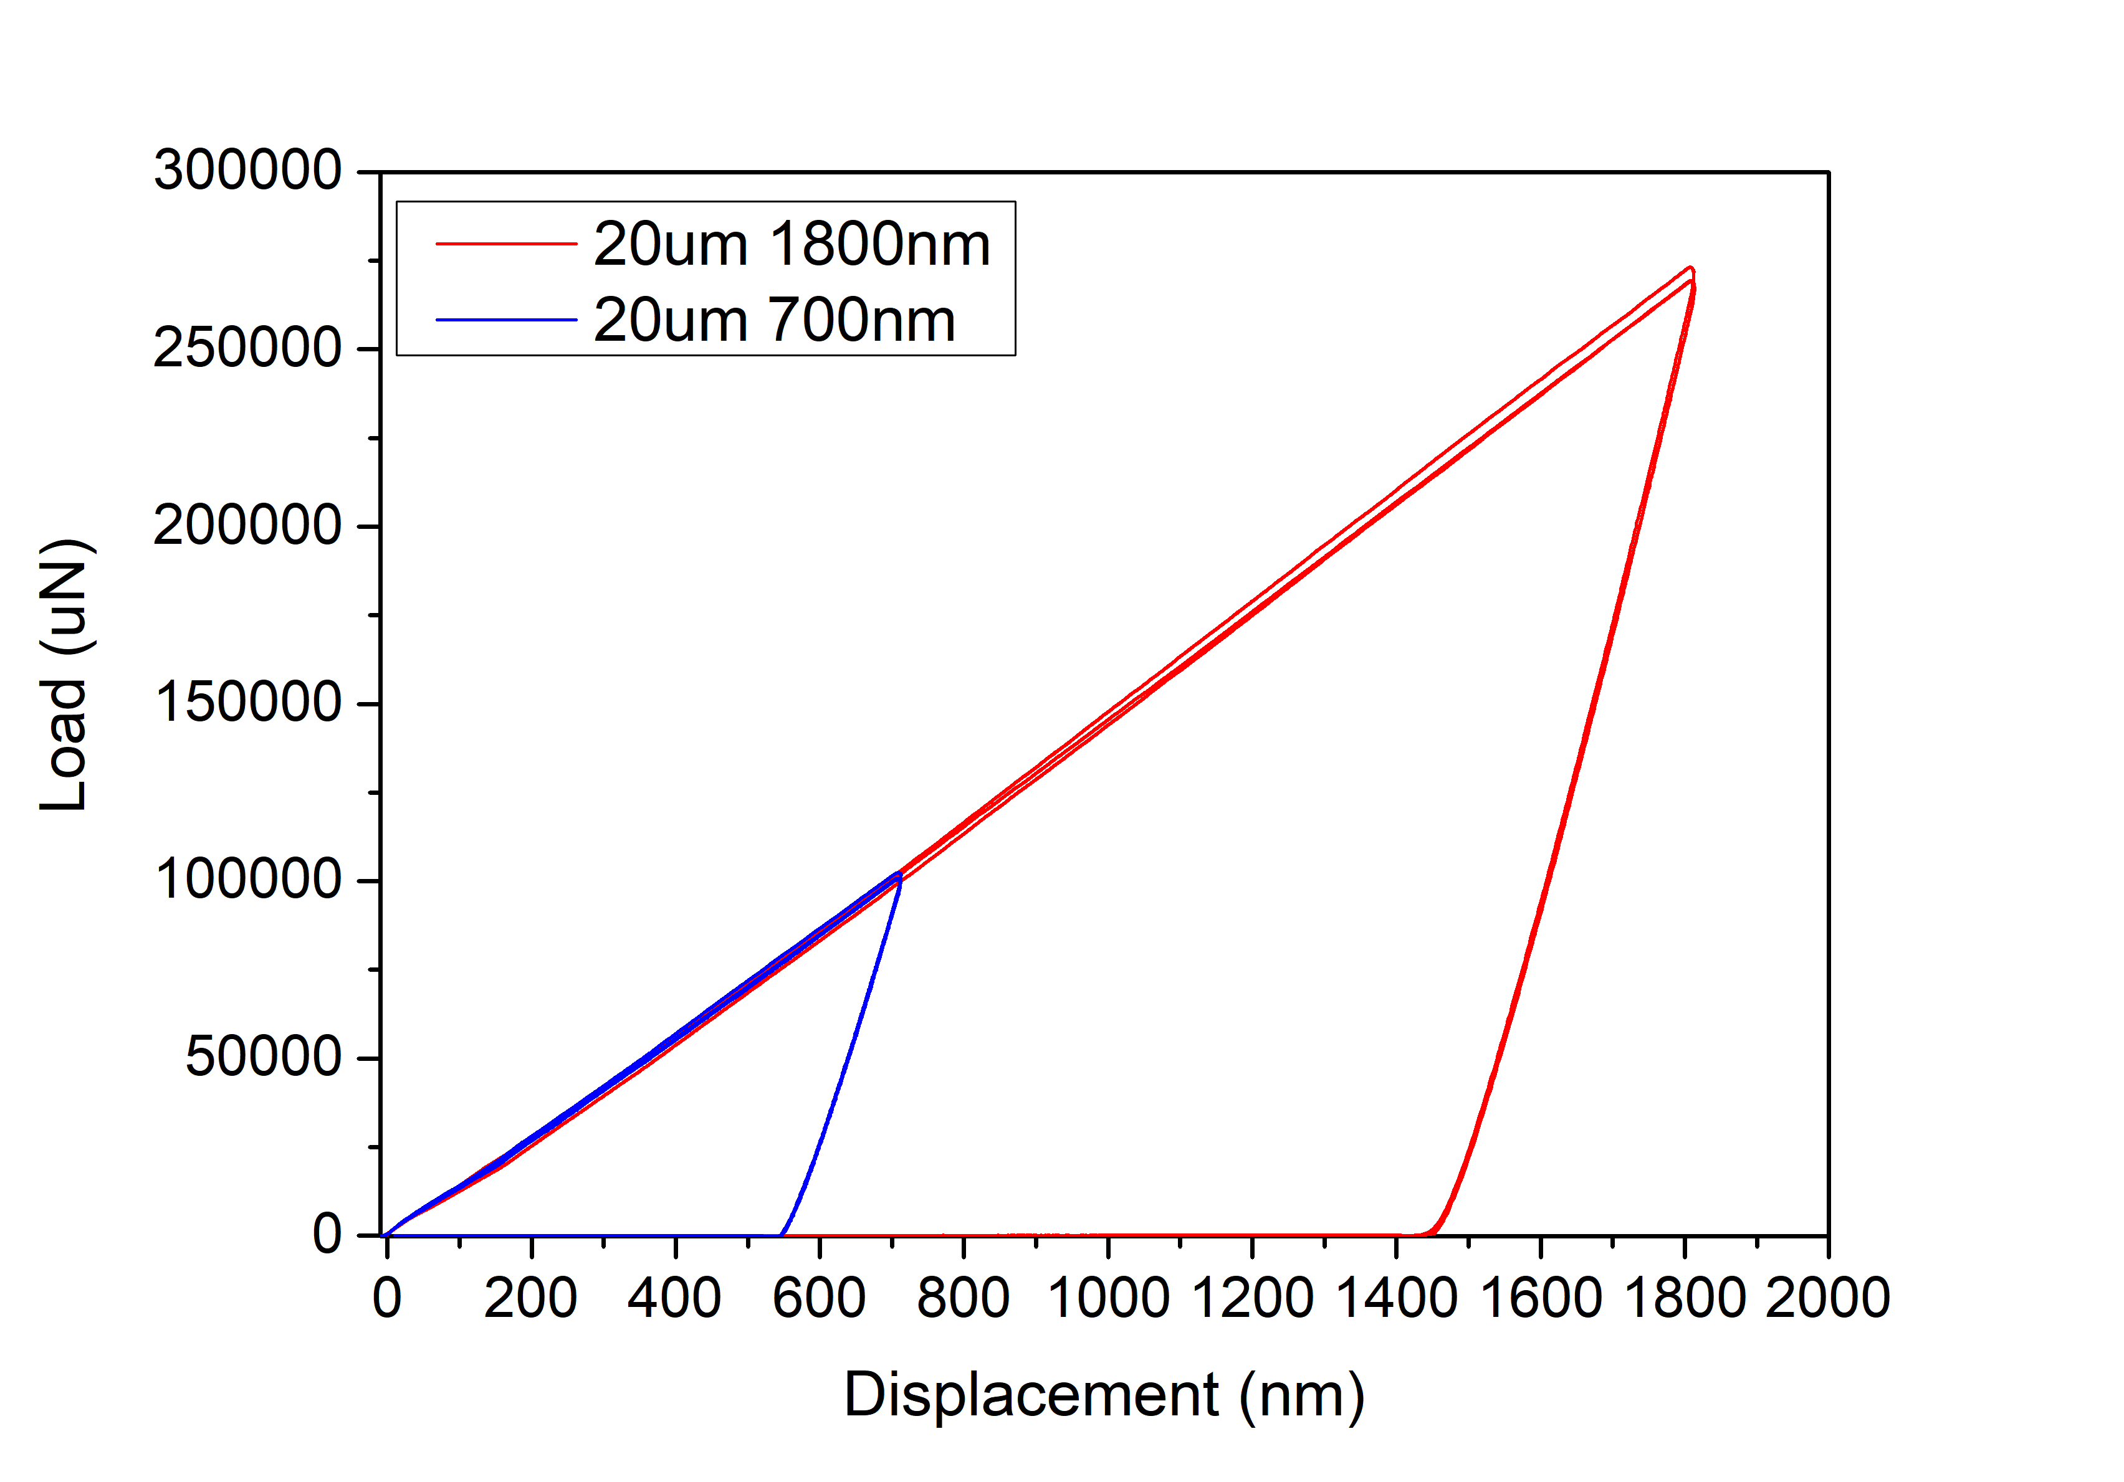
AISI439
Indenter radius 20um
1

Slide 10
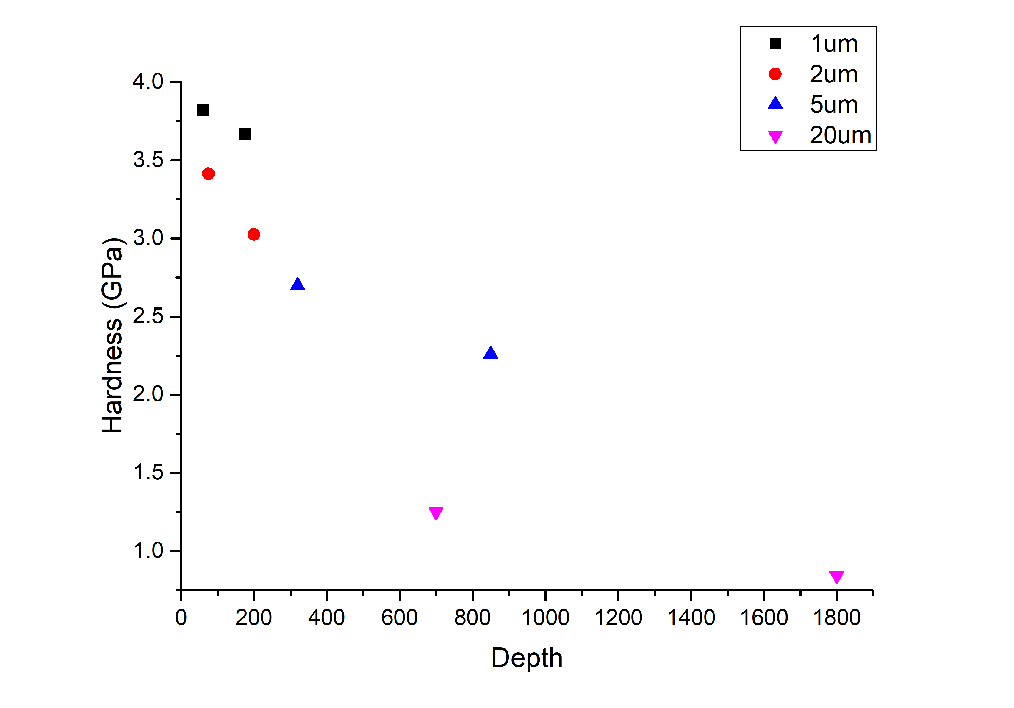
AISI439
Hardness
1

Slide 11
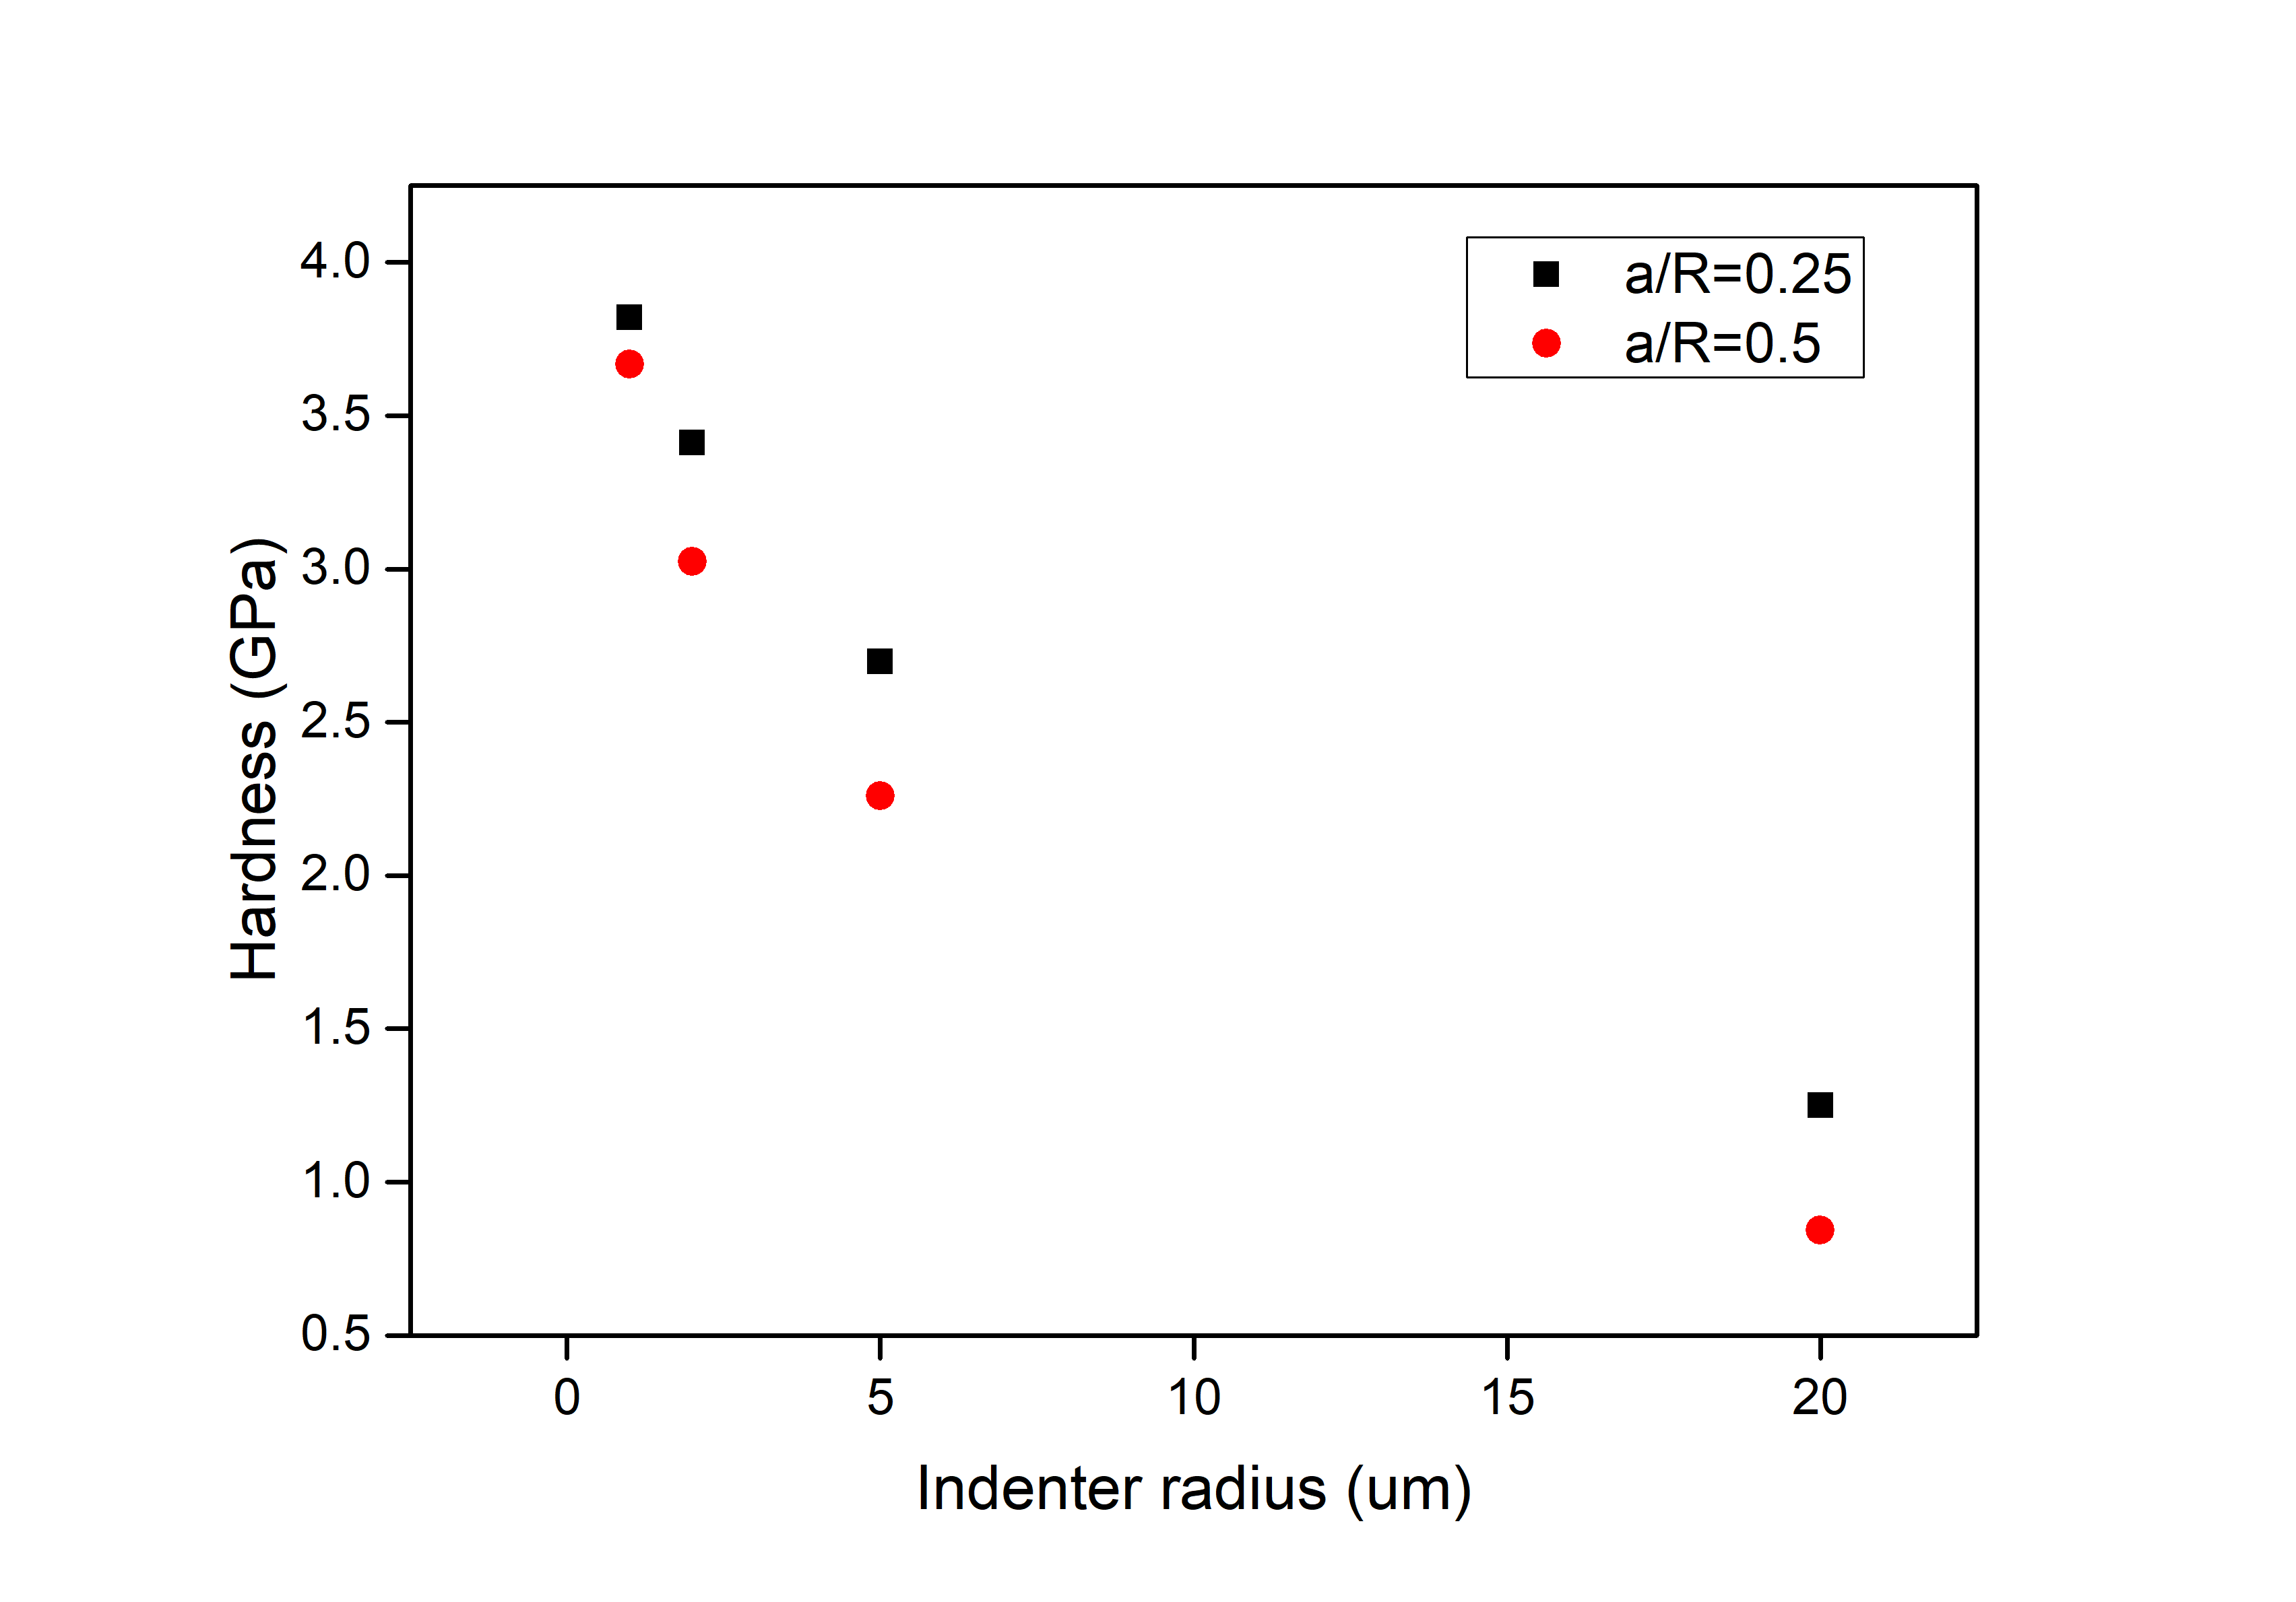
AISI439
Hardness
1

Slide 12
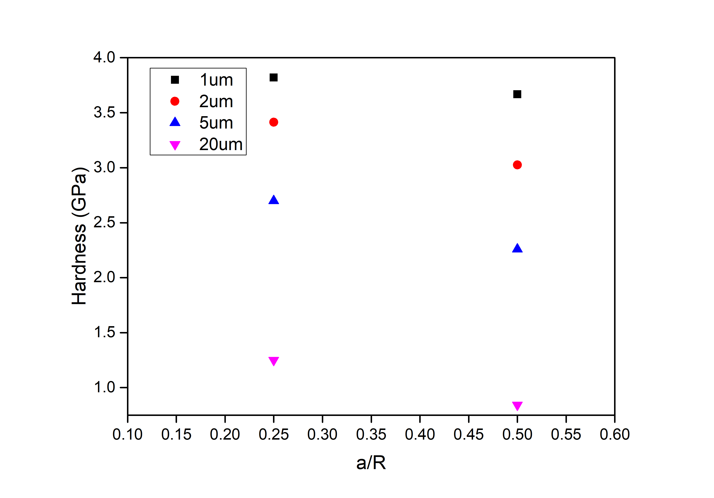
AISI439
Hardness
1

Slide 13
AISI439
Hardness
Indenter radius R (um) | contact radius a (um) | Hardness (Gpa)
 |  | 1 | 2 | 3 | Average
1 | 0.25 | 3.74 | 3.90 | 3.82 | 3.82
 | 0.5 | 3.69 | 3.61 | 3.70 | 3.67
2 | 0.5 | 3.46 | 3.43 | 3.35 | 3.41
 | 1 | 2.91 | 3.07 | 3.09 | 3.02
5 | 1.25 | 2.83 | 2.61 | 2.66 | 2.70
 | 2.5 | 2.32 | 2.30 | 2.16 | 2.26
20 | 5 | 1.27 | 1.25 | 1.24 | 1.25
 | 10 | 0.84 | 0.84 | 0.85 | 0.84
1

